Slide 1
How web tagging is leveraged by businesses
Basic Overview
6th May 2014

Slide 2
What is web tagging?
Tagging, as we understand in general, is adding to some information to denote something; like labelling.
In the website world, tagging is done by attaching a small piece of code to an action/event/page on a website
Tags primarily let you understand what is happening on your site? - Traffic, customer/visitor behavior, effectiveness of different features on the site, weak spots in the site/flow design, sales funnel etc.
Some tags are used to count something happening on a page while some are used to see where did it happen, what happened after that, who is it etc.
There are various tag implementation and analytics frameworks in the market – most popular being Omniture, Google analytics, Web trends

Slide 3
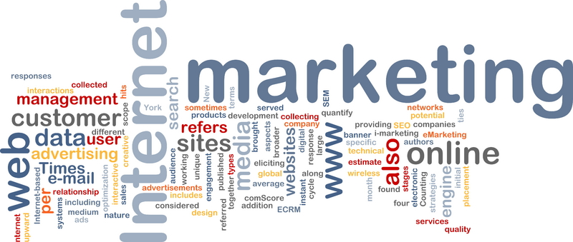
Where does a business leverages tagging?
Web design optimization
Reach
Customer attributes and engagement
Advertising and Marketing
Sales
Service and support
Social media

Slide 4
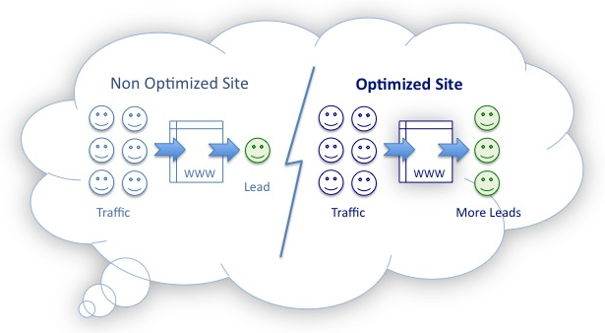
Website optimization
Tags are also used to measure the performance of your site or redesign it in certain ways
Tags could capture how the visitor arrived at your site, how he traverses the content and what has he searched on the site and so on
Page timeouts, error codes generated, page load time issues, page not found instances etc. could be tracked
Personalization of the content based on the visitor characteristics tracked through tags is possible
E.g. Use case – After identifying the paths taken by a Flipkart’s customer after a cart addition, we found that people drop off when asked for login and hence redesigned the process to login through our Google/FB account
Examples of tags in this area
Page load error
Timeout flag
Next page
Exit page flag
Cart error
Payment gateway timeout
Previous search keyword

Slide 5
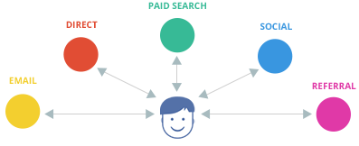
Reach
Visitors come to your website through different channels
Tagging enables to understand the reach of your website in terms of volume of the visitors, where they come from, what were they searching for, who referred them here
Tags also help you see who is that you reached to and which is the channel that helped you the most
E.g Use Case: After identifying the loyal visitors by IP tag / Customer ID tag and frequency of visits, we assign tags as counters which gave cumulative number of visits made by customers and also the customers who hadn’t visited in the given time frame
Examples of tags in this area
Country
Repeat visitor flag
Search keywords
Source Search engine
Facebook fan

Slide 6
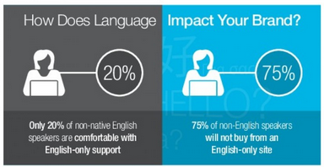
Customer attributes and engagement
Tags are used to track the customer engagement on the site and identify various behaviors of visitors
To understand
  Who is your customer and who is not
  Any onsite behavioral trends based on Ethnicity, Sex, Income range, Region, Language
  Who preferred a certain product/service and why
  Which are the most popular sections with your customers, Customer satisfaciton
  Different actions performed on the site
  E.g Use Case: After identifying the customer attributes like location and frequency of visits, we can generate insights on the type of promotions to roll out across regions, to maximize returns
Examples of tags in this area
Customer ID
Visitor location
Session length
Frequency
Language

Slide 7
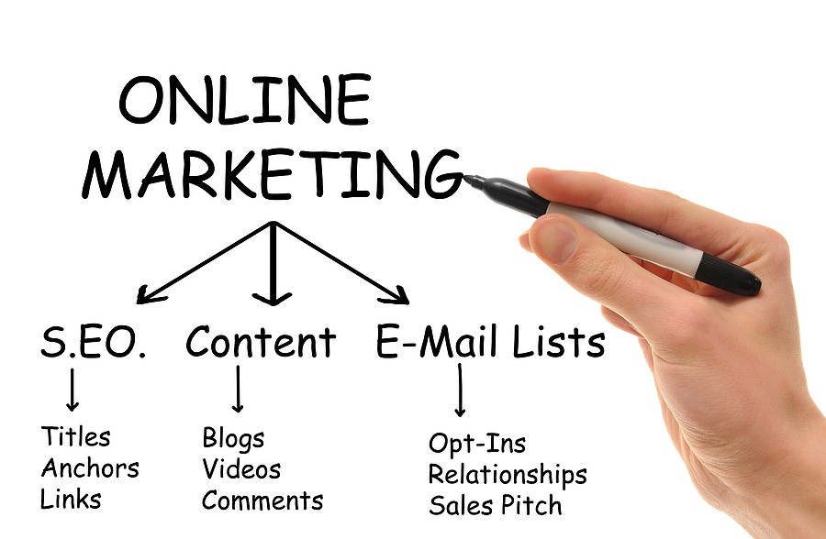
Online advertising, marketing and sales
Tags brought agility into online marketing by enabling marketers to manage/track the campaigns easily
Content in the mailers/advertisements are tagged with the right and popular keywords for maximum ROI
Designing targeting solutions to aim specific set of customers is possible through tags
Identify leakages in sales funnels, cart abandonments and take impromptu actions to complete the sale
Eg Use Case: In amazon’s promotions, Tags help in identifying the referral source which has led the customer to the site and thus helped in identifying the low performing marketing channel, ROI and reasons behind it to drive customer response
Examples of tags in this area
Campaign ID
Seen ad already flag
Email coupon
Demographics
Past sales section visitor

Slide 8
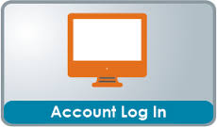

Service and support
Key Problem Areas – Proper tagging of service/support section of the website will help you ascertain the problem area of your customer. Article/Video views, Article/Video Resolution rates
Success Rate of major flows – Success rate of major payment flows, new services enrolment and registration flows can be calculated through tagging
Call/Chat Deflection – Tagging will help us determine how many of our customers go on to use different support avenues other than online
Service Adoptions – Apt tags on key service areas will help us determine the adoption of our major services such as online account management, autopay and paperless through the online channel
Eg use case: In an e-commerce site, estimate of number of billing events made across types available is forecasted so that payment gateways shall function smoothly at high customer traffic and thus ensure customer satisfaction
Examples of tags in this area
Current page URL
Next Viewed Page
Referral URL
Event triggered

Slide 9



Social Media
Campaigning and advertising – Increased of social media has led to it being an active tool for campaigns and advertising. Through tagging, we are able to assess the effectiveness of our social media campaigns and advertisements
Support –Tags on social media websites alert the customers of an issue through twitter hashtag, facebook comments and can be responded to quickly
Traffic Source – Tagging helps us ascertain the traffic on our website through social media outlets
Market Research – Twitter/Facebook tags of your company or domain will help you ascertain the current market trends, customer sentiment and increase your reach to the customers
E.g Use Case: Using tags like ‘like’, ‘share’, commented/not, visitor id we can measure the effectiveness of a facebook page promotion campaign and hence generate ideas to increase the impact of the campaign
Examples of tags in this area
Media channel
Keyword
Campaign Name
Media type

Slide 10
References
http://www.emarketingandcommerce.com/article/5-ways-tag-management-benefits-digital-marketers/1
http://moz.com/blog/why-google-analytics-tagging-matters-whiteboard-friday
http://www.google.com/analytics/customers/

Slide 11
Appendix
Case studies

Slide 12
More about multiple traffic sources to a particular website
The “Traffic Source” is the source through which the visitor entered the concerned website. These are also referred as “Traffic Vehicles”.
Traffic Source | Meaning
Paid Search | Visitors coming to the website after clicking on one of the Paid search results
Organic Search | Visitors coming to the website after clicking on one of the Organic search results
Typed/Bookmarked | Visitors coming to the website by directly typing the website/webpage url or by using the bookmark
Social Media | Visitors coming to the website after clicking a link present on any Social Media website
Email | Visitors coming to the website after clicking on an email link
Campaign | Visitors coming to the website after clicking on an campaign link

Slide 13
Mu Sigma conducted an analysis on click stream and survey data to understand how site behavior impacts satisfaction …
Path Analysis and Page Link Analysis
Business Case
Result
Perceptual data about a site visitor’s experience on web portal of a software major and behavioral data on site usage were collected and analyzed separately.
Client needs to understand how site visitor behavior (pages visited, action taken) is linked to customer satisfaction results.
To understand that, a pilot was conducted - the target audiences are site visitors to the Product Information Center (PIC)
To understand Page link Behavior to drive more traffic into the website
Using the data, Mu Sigma’s mission was to devise a replicable analytical framework for future implementations
Satisfaction has three factors – Discoverability, Content & Appearance. Discoverability is the most important driver of satisfaction
Use of site search engine, number of clicks and not accessing PIC from home drives dissatisfaction with discoverability the most
Visitors with “trial software” as their most visited pages are the most satisfied.
First timers are using more of site search and hence more dissatisfied
Non-US customers are not as satisfied as their US counterparts
Similarly the Non Home Users are not satisfied with the PIC
Approach
Basic (univariate, bivariate etc.) and advanced (CHAID segmentation, logistic regression) analytical techniques were used to answer -
  How do the visitors perceive PIC ?
  Is their perception affected by the sections visited ?
  How is their navigation pattern affecting perception ?
  Do the findings change based on customer type?
Highlights:
Automated routine to read the website page name automatically from the URL
Marrying behavioral data with perception data to get richer learning

Slide 14
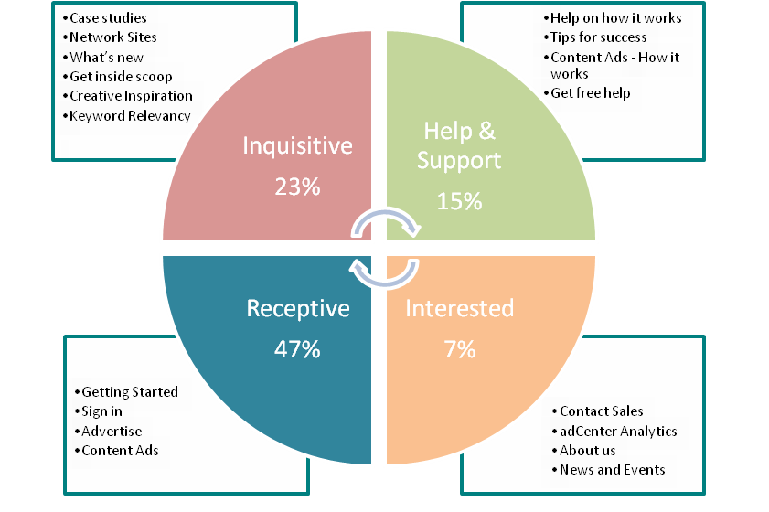
… and established a process to replicate it cost effectively
Path Analysis and Page Link Analysis
Future Direction
The Key Drivers of Satisfaction
We have established an analytical framework to make the analysis repeatable
We have scoped the incremental effort required to
  Further automate some manual processes
  Replicate the same analysis for other websites in X.com
Incremental effort per site is reduced by 67%
Illustration
Satisfaction varies by category visited
Back

Slide 15

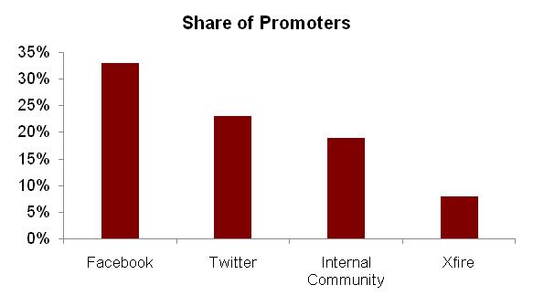
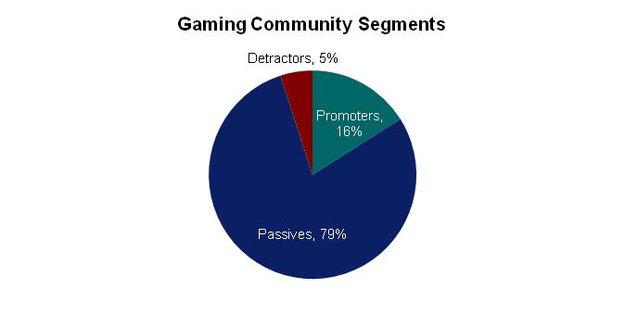
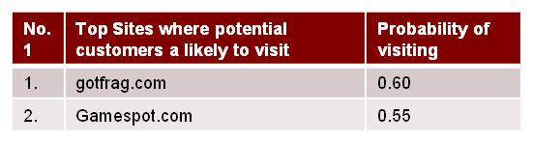
Mu Sigma helped a leading technology client use Social Media to identify promoters and sales targets from its online community
Social Media - Scoring
Business Case
Results & Observations
The Client is a Fortune 500 Information Technology corporation with a wide portfolio of products and services
It has a strong presence in Social Media platforms such as Facebook, Twitter and also hosts an online community
Social Media is a marketing tool that can be leveraged for targeting the online community
Client wants Mu Sigma to develop a customized social score for its online community members so as to:
  Identify key promoters and potential customers
  Identify their online preferences
Approach
Data collection and collation across Social Media platforms at a user level
  Using various client data sources such as survey data, transactional data and Social Media tools e.g. Radian6
Scoring methodology involves identifying variables relevant to business and developing a scoring algorithm
Profile the community members based on their social scores and affinity towards other websites
Business Impact
The analysis helped the client to:
  Identify promoters and potential customers among its community members
  Identify sites where potential customers are most likely to visit
    Improve online demand generation
Back

Slide 16
Mu Sigma helped a leading technology client use Social Media for customer acquisition and retention
Social Media - Customer Targeting
Business Case
Results & Observations
The Client is a Fortune 500 Information Technology corporation with a wide portfolio of products and services
The Client has a collaborative online community where visitors can get in-depth technical information about the products, participate in discussions, download content, post queries, etc.
The Client wants Mu Sigma to:
  Ascertain the impact of the website on the purchase behavior of its customers by analyzing patterns in visits and revenue
  Use Social Media for refining its marketing strategy for targeting its business customers better
Significant sales potential is generated from the community forum
Compared to non-visitors, visitors to the site showed a higher product penetration and incremental revenues
The website is also used by visitors for technical support
Approach
Data collection and master data creation using various client data sources such as transactional and visits data
Exploratory analysis on the visits and revenue trends and draw qualitative insights into the observations
Understand what content is the most visited on the website and suggest recommendations for making it more engaging
Establish causality for a few firms by analyzing the content visited and the associated products purchased at a weekly level
Establish the incremental revenue and wider product penetration for visitors as compared to non-visitors of the site
Business Impact
  Helped identify
    The content which the visitors consume the most based on the pages visited and keywords searched
    Profitable customers for targeting marketing communication effectively thus saving advertising costs and efforts
  Also, aided in integrating the community websites into their customer acquisition and retention strategies
Back

